Slide 1

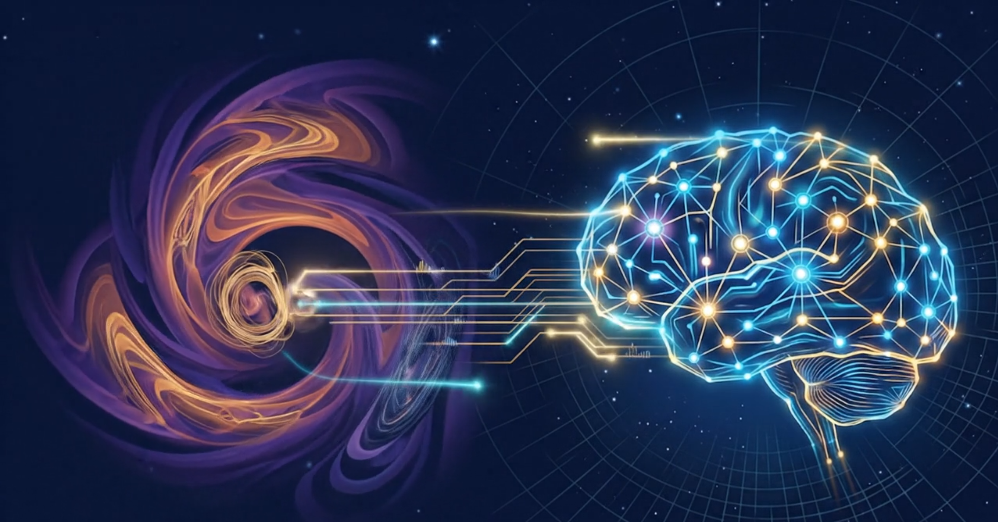


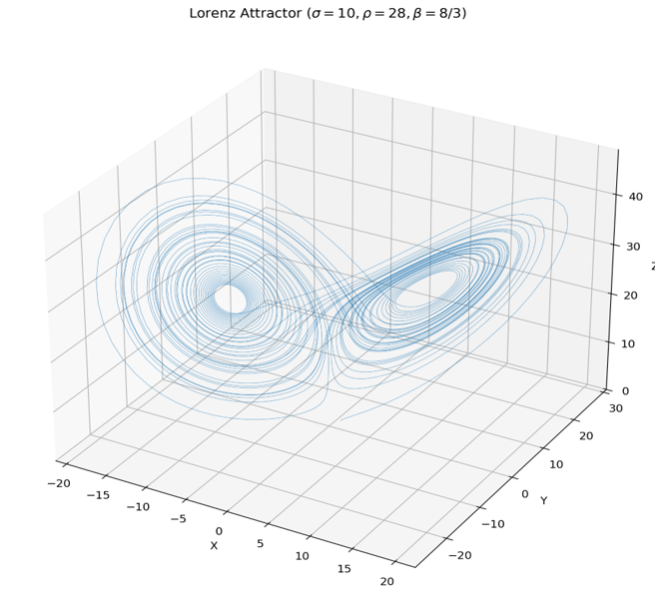
Chaos-Informed Forecaster — Lorenz Validation
Architecture: Chaos-Informed NGRC–TCN Encoder–Decoder
Ibrahim Hanafy
Validation on Lorenz Chaotic System
Deterministic, noise-free system with known Lyapunov exponent
Cleanly isolates whether the architecture can learn chaotic dynamics
Phase-space reconstruction (PSR) + NGRC nonlinear feature expansion
Results
R² = 0.996 at 0.23 Lyapunov times (short-range)
R² = 0.954 at 1 full Lyapunov time (long-range)
Shuffled-target control: R² = −0.005 — no data leakage
Recursive (closed-loop) forecasting tested successfully
Key Finding: Input-Length Ablation
Input window reduced 540 → 64 steps: R² at 1λt jumped 0.34 → 0.96
Shorter input removes redundant attractor orbits, improves focus
Next Step
Tuning and testing this architecture on real ECG signals
Adapting chaos-informed features to stochastic biomedical data
Agenda
Introduction
Background
Problem
Proposed Solutions
Case Study
Discussion
Conclusion
06

Slide 2
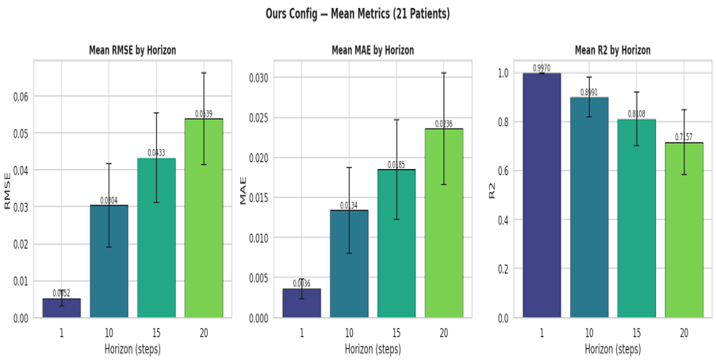
TCN Multi-Step ECG Forecasting — MIT-BIH
Dataset: 21 MIT-BIH patients (excl. 111 & 118) | Horizons: H = 1, 10, 15, 20 | Multi-Output (MIMO)
Ibrahim Hanafy
Configuration Comparison: Ours vs Paper (Dudukcu 2023)
H
RMSE
MAE
R²
Paper: 1 residual block, 256 filters, batch 128
Ours: 3 residual blocks, 64 filters, batch 256
Deeper network with smaller filters → better generalization
Outperforms the paper across all horizons and all metrics
1
10
15
20
Paper
Ours
Paper
Ours
Paper
Ours
Paper
Ours
.0061
.0052
.0344
.0304
.0471
.0433
.0571
.0539
.0037
.0036
.0148
.0134
.0200
.0185
.0253
.0236
.9952
.9970
.8776
.8991
.7847
.8108
.6894
.7157
Overall Mean (21 patients)
Ours: RMSE = 0.0332 | MAE = 0.0148 | R² = 0.856
Paper: RMSE = 0.0362 | MAE = 0.0160 | R² = 0.837
Improvement: −8.3% RMSE, −7.5% MAE, +2.3% R²
Future Work
Hyperparameter optimization: Optuna TPE with pruning, plus Grey Wolf Optimizer (GWO) comparison
Extend evaluation to additional patient populations and longer horizons
Agenda
Introduction
Background
Problem
Proposed Solutions
Case Study
Discussion
Conclusion
07

